Slide 1
Ontology Community
BDK14-3 | Ontologies 101
Melissa Haendel and Nicole Vasilevsky

Slide 2
Learning Objectives
1
Identify websites to view or lookup ontologies
Identify ontology editing software
Write a good term request for a new ontology term
Understand how ontologies are reused
2
3
4

Slide 3
Ontology websites
How can I view an ontology?

Slide 4
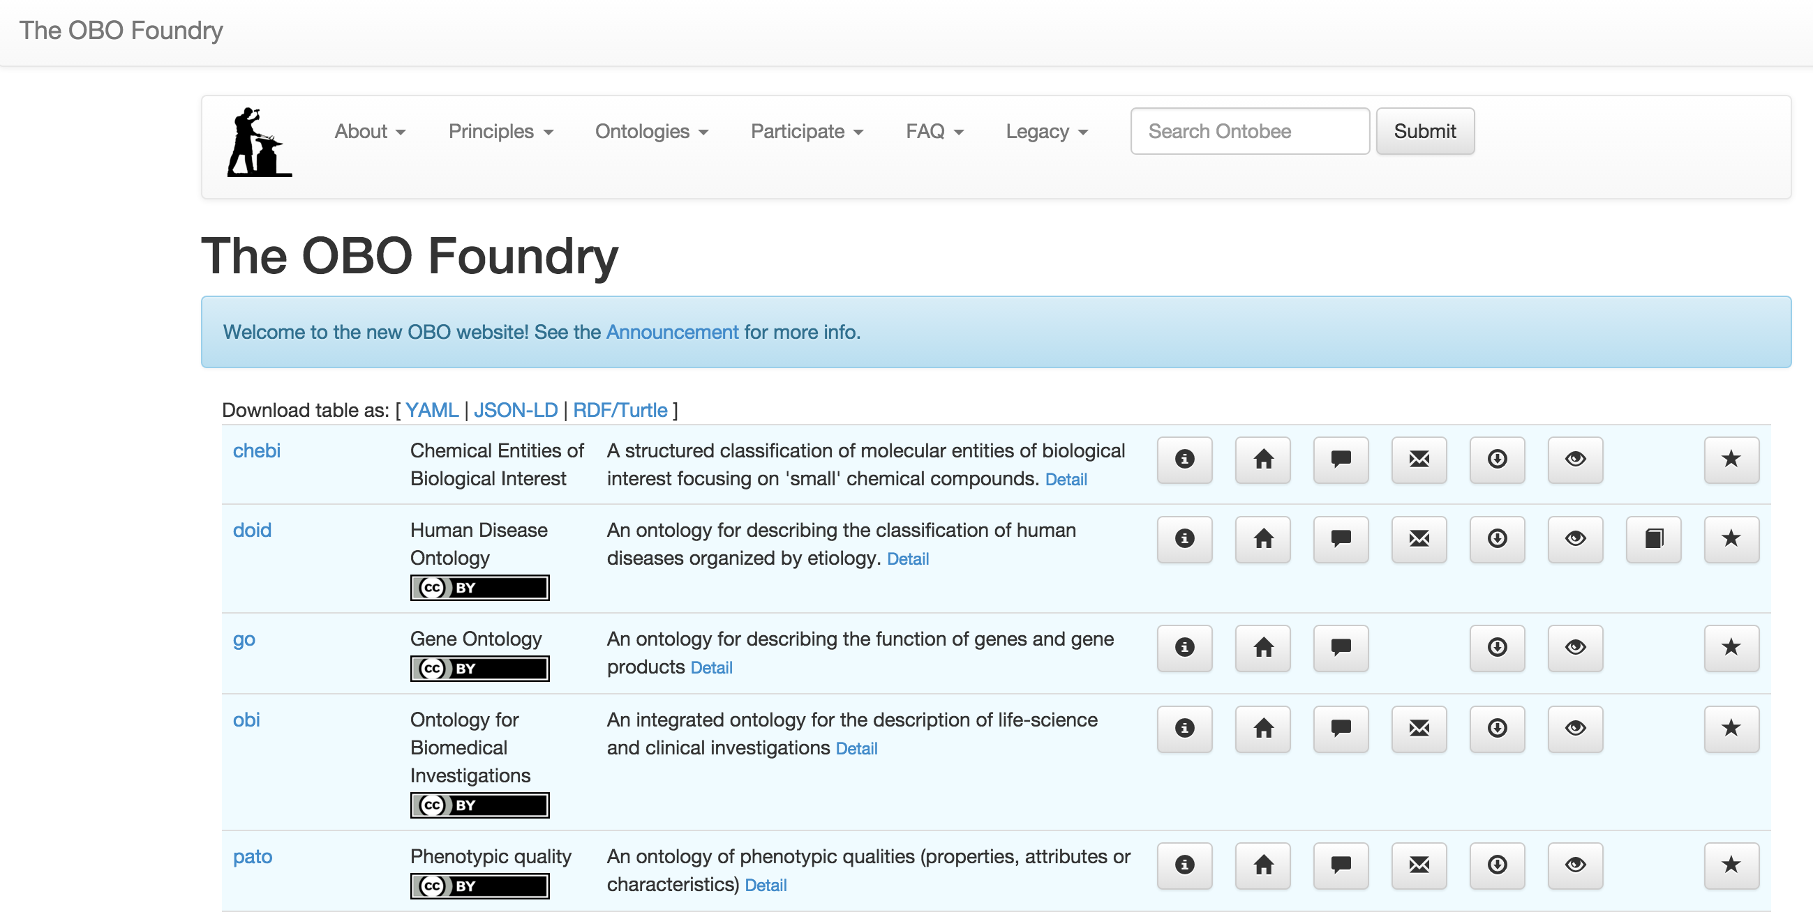
The OBO Foundry
More than just a website, it’s a community of ontology developers dedicated to working together using common principles

Slide 5


How can I collaborate or stay informed?
The OBO Foundry has a number of listservs to coordinate collaborative efforts.
Note that most of these are fairly low traffic, and these are archived.
See Resources tab for more info.
Notes:
TO DO: look for new links

Slide 6
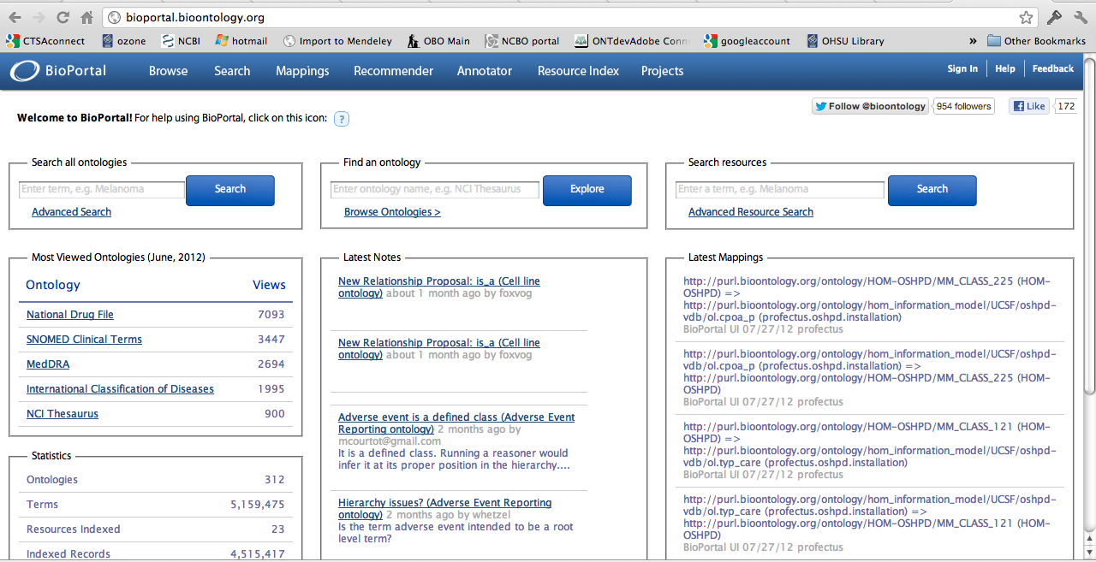
National Center for Biomedical Ontologies Bioportal
A library of ontologies and ontology related services

Slide 7
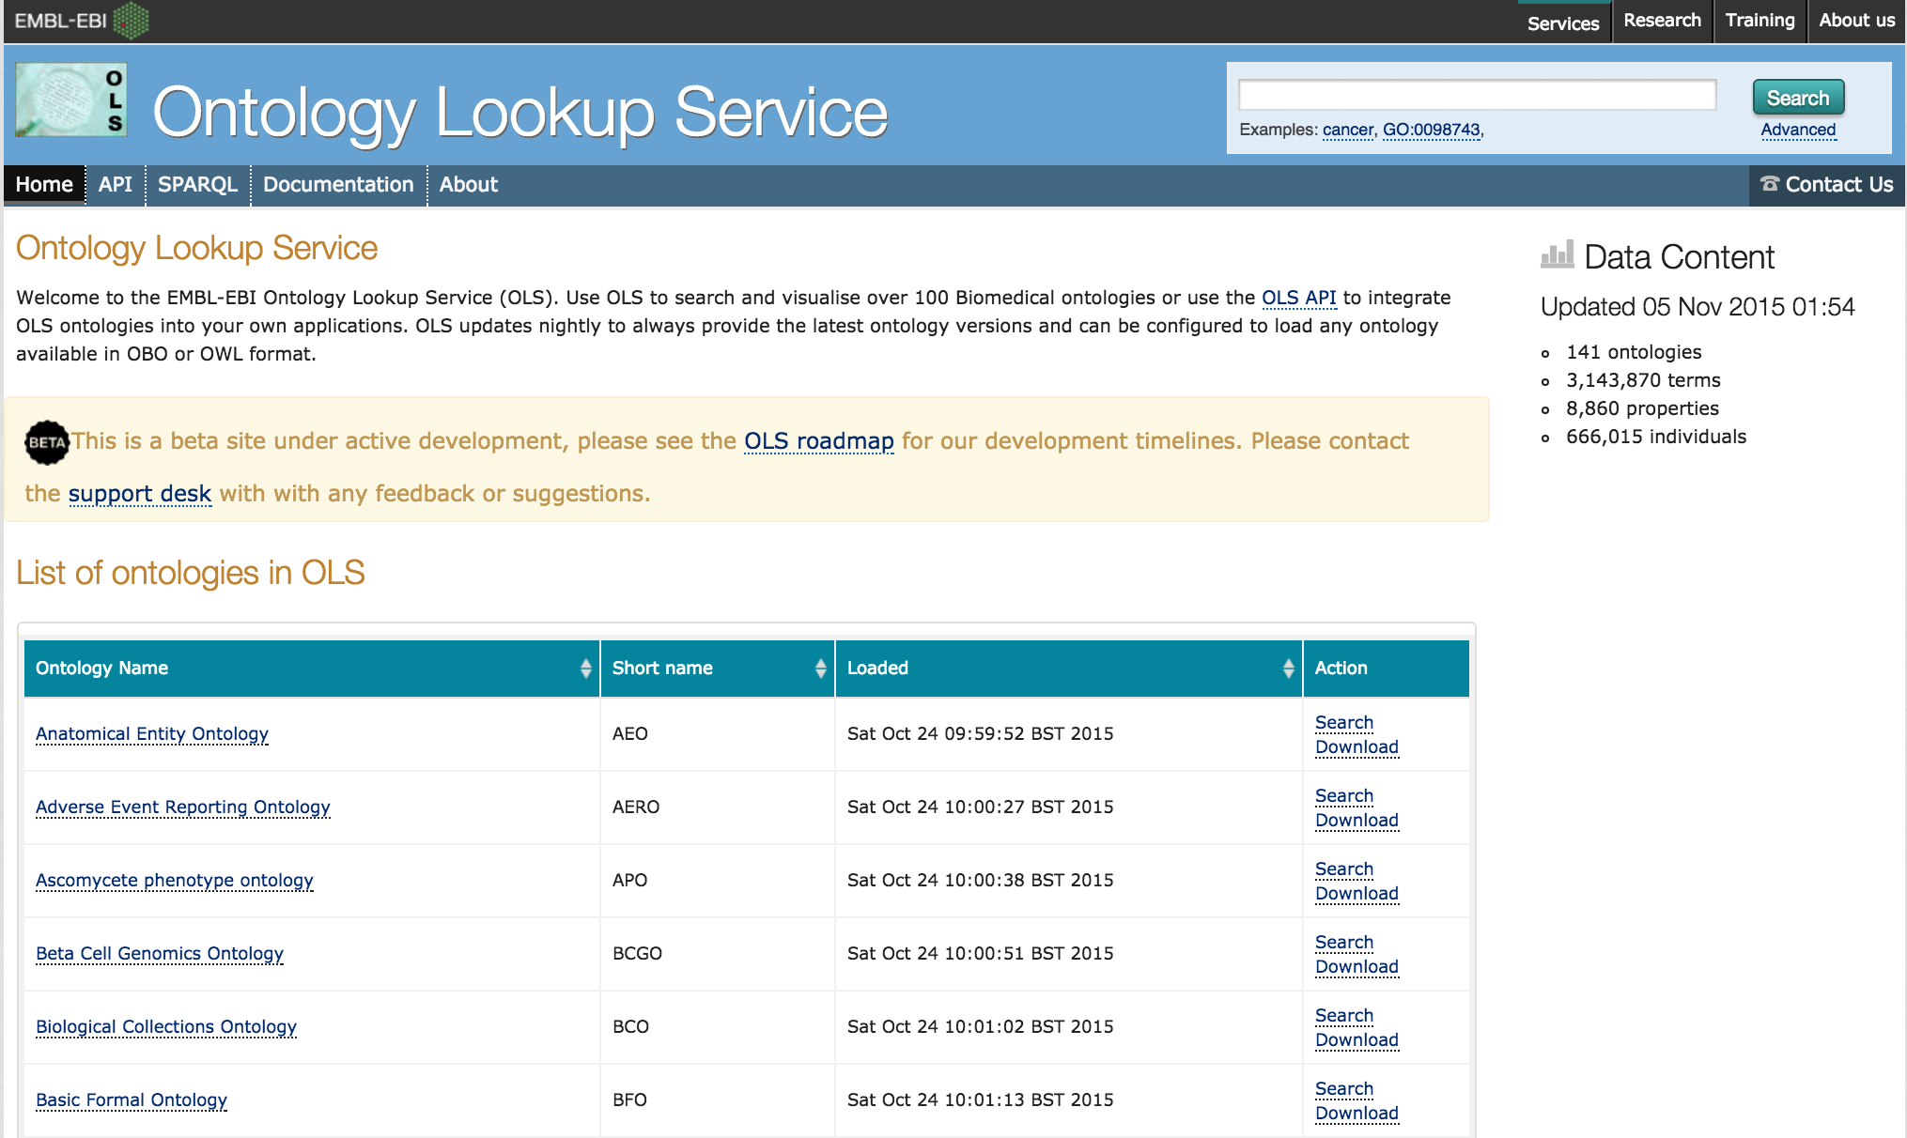
Ontology Lookup Service

Slide 8
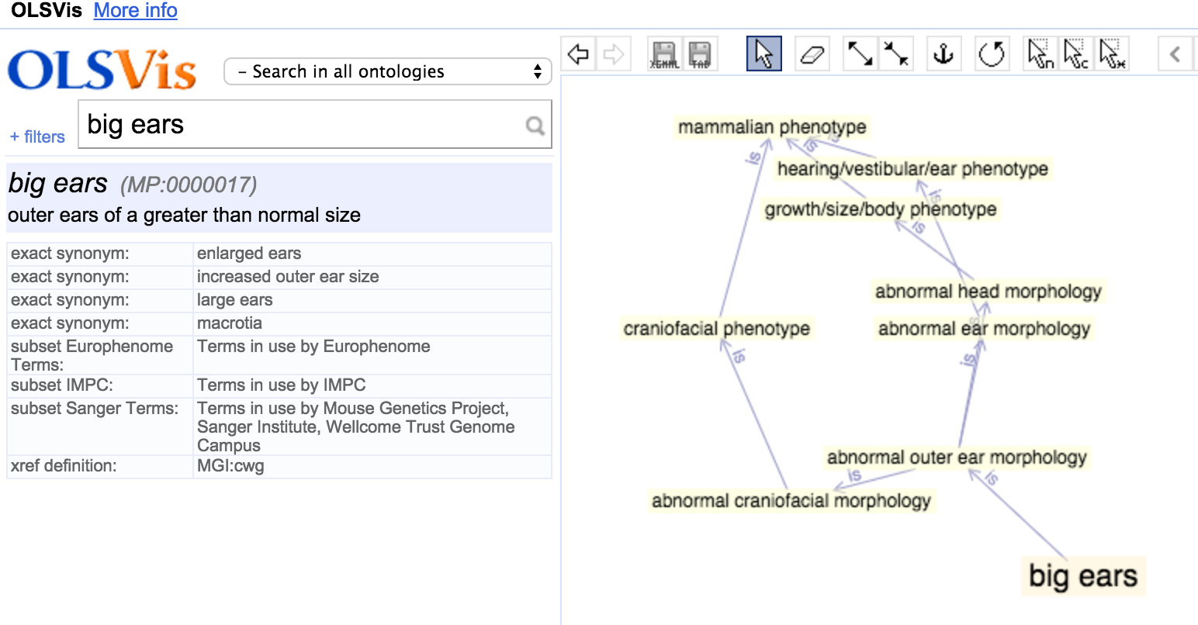
Ontology Lookup Service
Query and visualize OBO ontologies

Slide 9
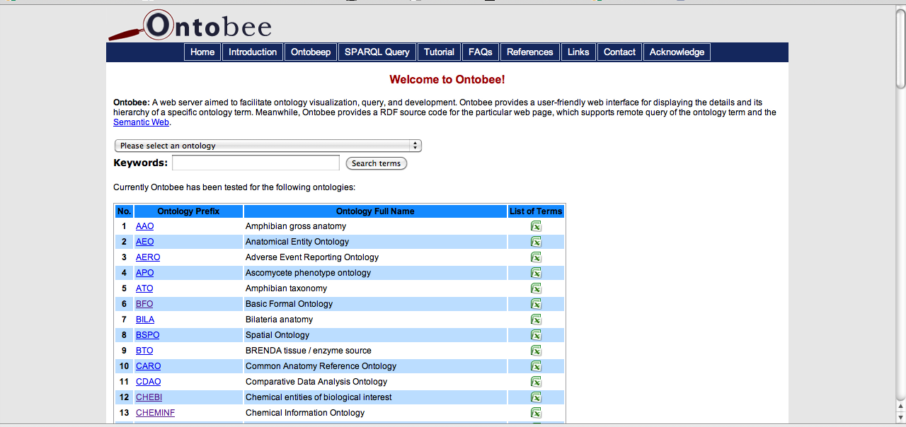
Ontobee
Query OBO ontologies, and provides RDF supporting remote query of each ontology term and the Semantic Web

Slide 10
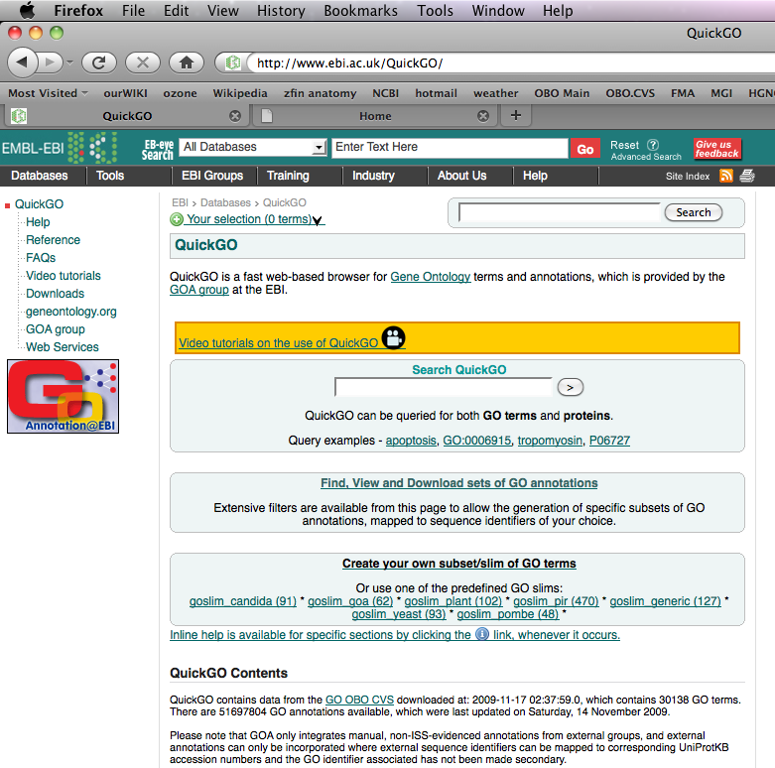
QuickGO at the EBI: Gene Ontology Viewer

Slide 11
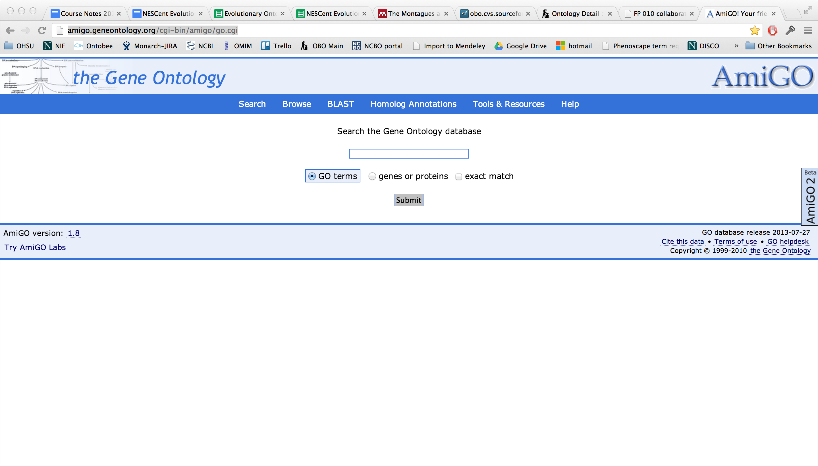
AmiGO: Gene Ontology Viewer
Notes:
http://amigo.geneontology.org/

Slide 12
Ontology Editing Software

Slide 13



Ontology Editing Software
Protégé - OWL ontology editor and viewer
Web-based version also available (WebProtege)
Vitro - an Integrated Ontology Editor and Semantic Web Application
OWLGrEd - a graphical ontology editor for OWL
Notes:
Image credit: https://commons.wikimedia.org/wiki/File:Prot%C3%A9g%C3%A9_Logo.gif

Slide 14
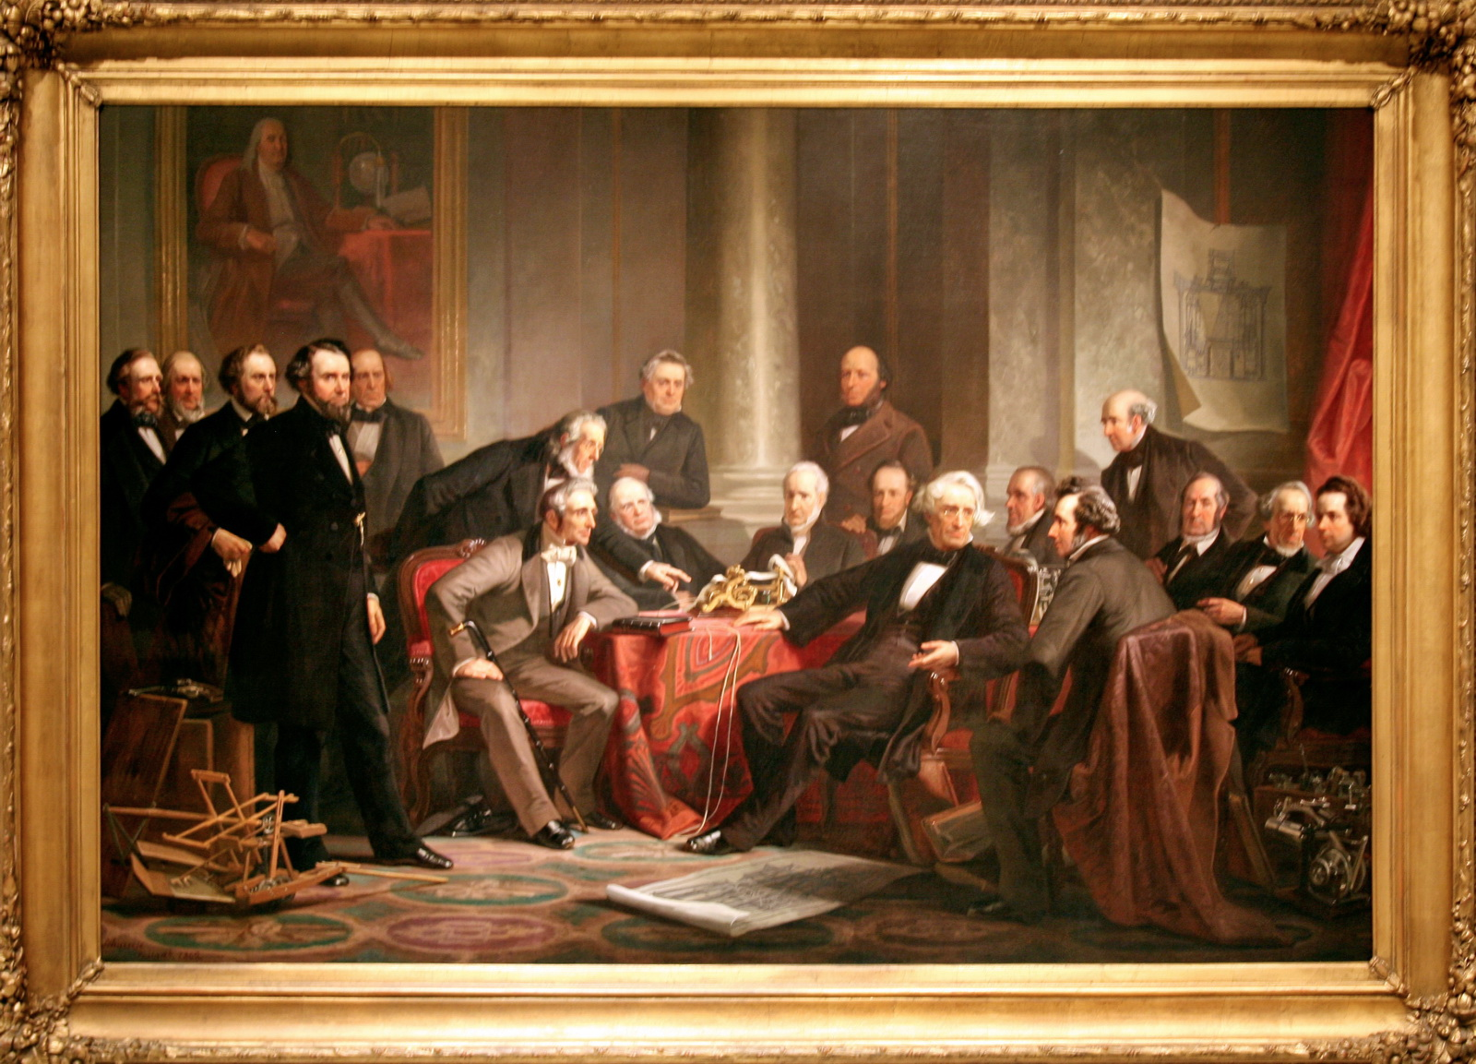
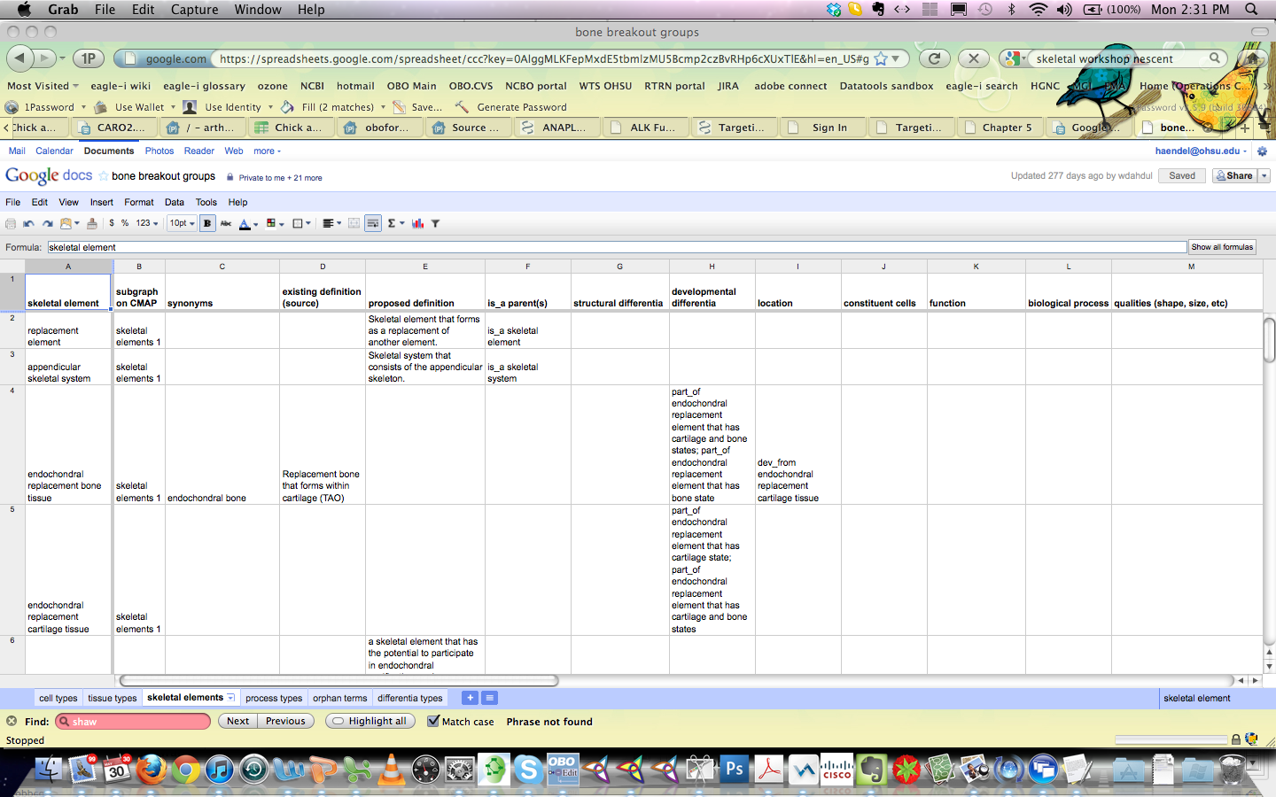
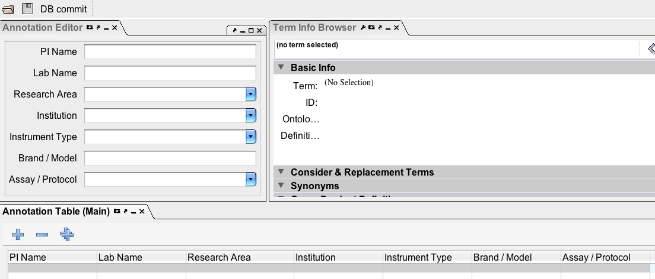
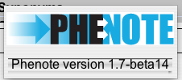
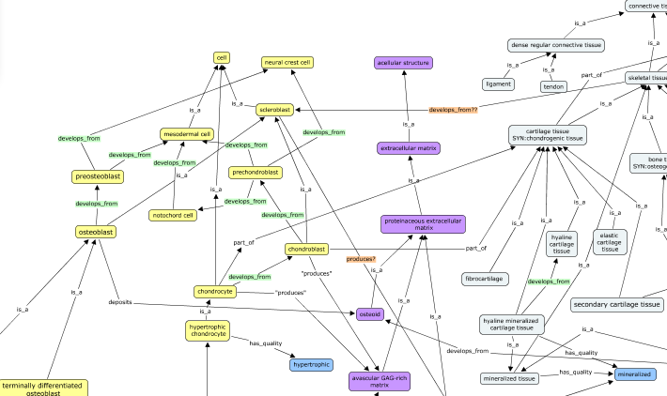
Mechanisms of extracting knowledge from domain experts
1862 Christian Schussele
Familiar tooling:
Google docs
Phenote
Excel
Visualization:
Cmap
Vue
GraphViz
Notes:
Image credit: https://commons.wikimedia.org/wiki/File:Men_of_Progress.jpg

Slide 15
Ontology Trackers

Slide 16
What is a tracker?
A tracker is a place to put a formal ontology request.
Trackers have long been used in the software community for keeping track of bugs, feature requests, etc.
In the ontology community, they are quite valuable because they provide a documented, structured requests for changes or additions.
Tracker IDs can be referenced in ontology metadata- such as in an editor note or definition annotation.

Slide 17

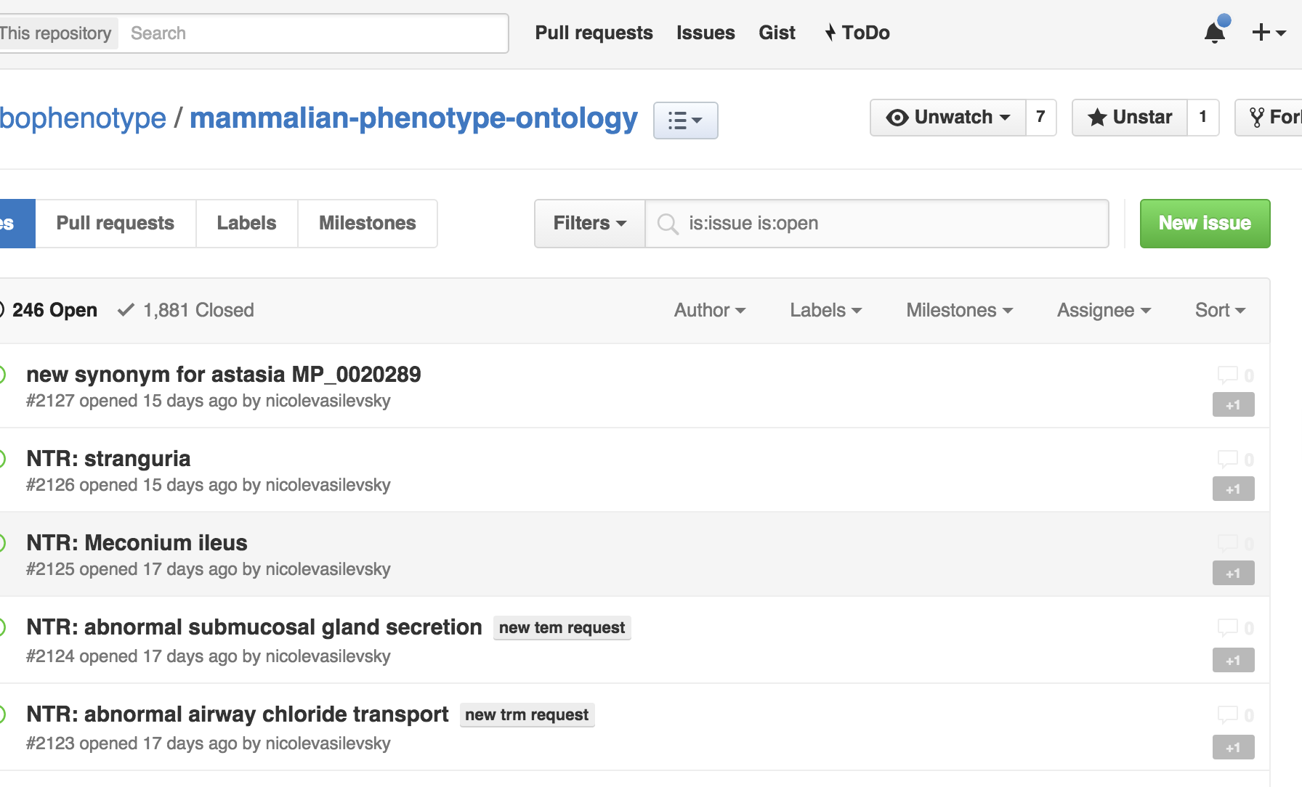
Github: A Common ontology tracker

Slide 18
How do you write a tracker request?
1
Provide as much information as possible, in order to facilitate the change you are requesting and future reference
For new terms, or term rearrangements, provide the intended hierarchy – both SubClass as well as any other relations required (such as partonomy)
Provide text definitions, that make sense in the Genus Differentia context, for all new or edited terms
Provide attribution for the definitions
2
3
4
Notes:
Make less text heavy, include interaction

Slide 19
Tracker requests
Some commentary may occur on the tracker item, but can sometimes lead to long listserv discussions before returning to a decision on the tracker
Complex issues requiring decision are best first discussed on the listservs or in design documents, but its always better to say something somewhere!
Notes:
Make less text heavy, include interaction

Slide 20
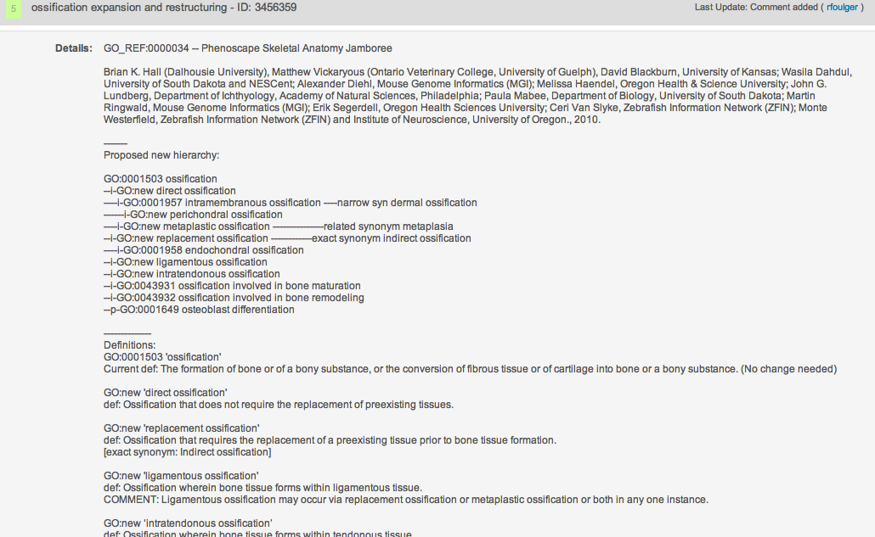
Example tracker request

Slide 21
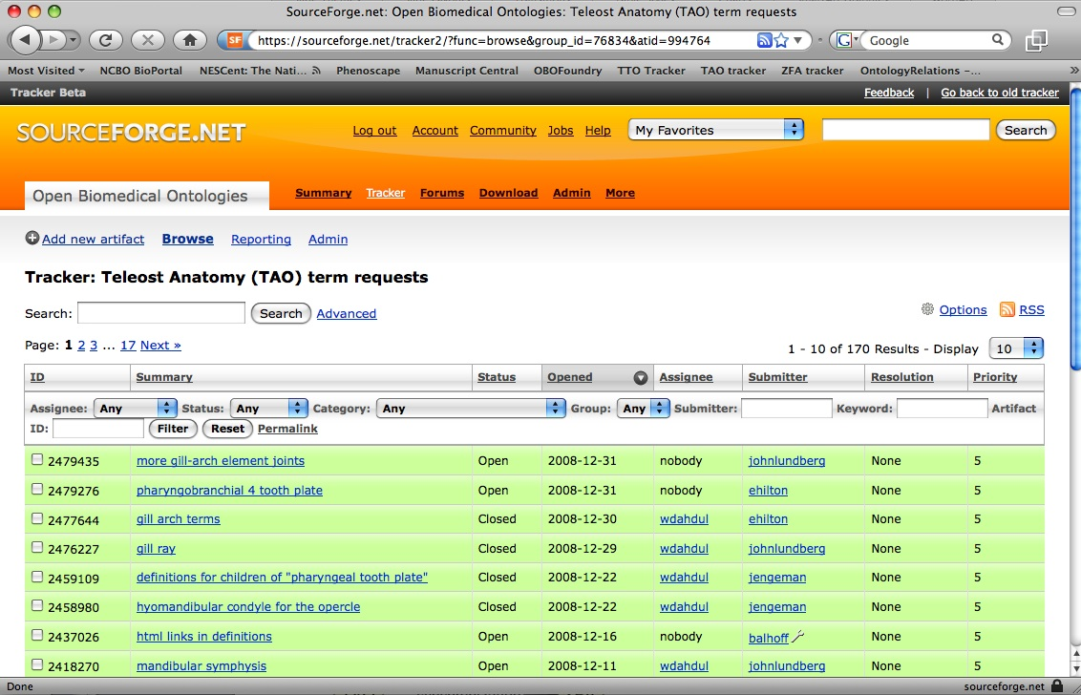
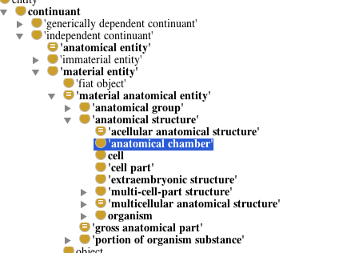
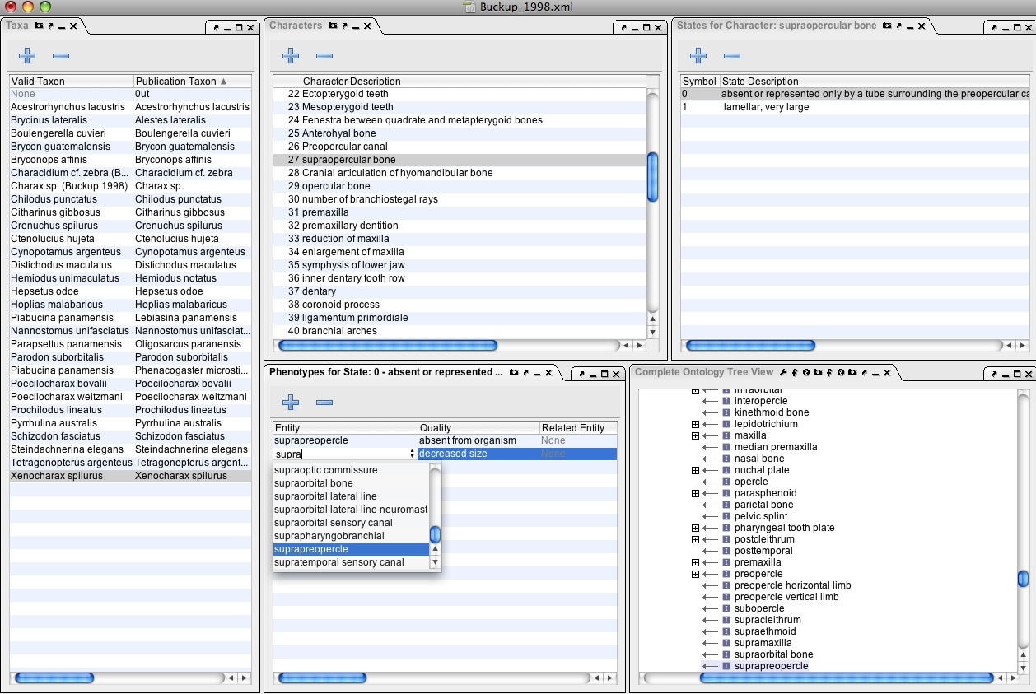
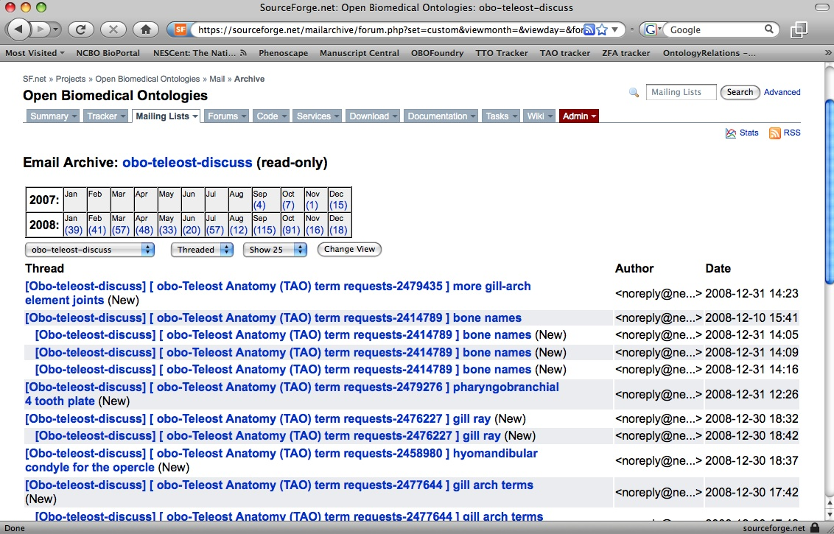
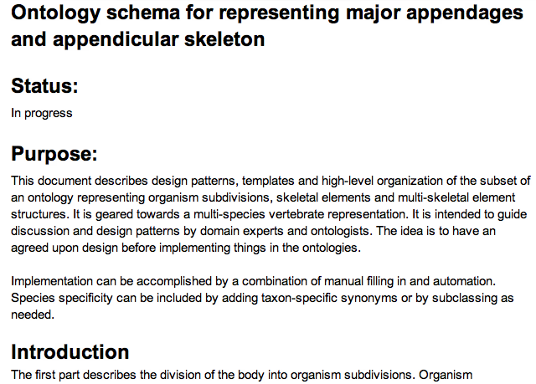
Lists, trackers, ontologies, annotation, oh my!
Ontology Edited
Tracker IDs can be in ontology metadata
Term requested
Term brokers are being developed to create temp classes during ontology editing or annotation
Trackers are often auto-emailed to integrated listservs
Design documents comment on existing ontologies
Term needed for annotation
Design and requirements analysis
Term discussed by community
Notes:
Add design documents

Slide 22
Ontology Reuse

Slide 23

Modularized Ontologies
Many ontologies are built from several modules and reuse parts of other ontologies
MIREOT – Minimal Information Required to Reference an External Ontology Term
Notes:
Image credit: https://pixabay.com/en/puzzle-pieces-jigsaw-piece-concept-308908/

Slide 24
Your work affects others
Example: Anatomy ontologies have very overlapping content
We can reuse common design patterns gaining us:
Interoperability
Ease of implementation
Quality reasoning power
Decreased duplicative effort
It is likely nothing you do in an ontology will remain siloed - eventually it will matter in the greater context
GO
MP
CARO
MA
UBERON
AAO
TAO
XAO
ZFA
CL

Slide 25

Resources:
OBO Foundry
OBO Foundry: http://www.obofoundry.org/
Sign up for OBO Foundry listserv:
https://lists.sourceforge.net/lists/listinfo/obo-discuss/

Slide 26
Resources:
Ontology websites
Bioportal: http://bioportal.bioontology.org/
Ontology Lookup Service:
http://www.ebi.ac.uk/ols/beta/
Ontology Lookup Service Viz (OLSViz):
http://ols.wordvis.com/
Ontobee
http://www.ontobee.org/
QuickGo:
http://www.ebi.ac.uk/QuickGO/
AmiGO:
http://amigo.geneontology.org/
Notes:
http://www.ontobee.org/

Slide 27

Ontology Editing Software
Protege: http://protege.stanford.edu/
WebProtege: http://webprotege.stanford.edu/
Vitro: http://vitro.mannlib.cornell.edu/
OWLGrEd: http://owlgred.lumii.lv/
Other Ontology Editors:
http://www.w3.org/wiki/Ontology_editors

Slide 28
Tools
Google docs: https://www.google.com/docs/about/
Phenote: http://www.phenote.org/
Cmap: http://cmap.ihmc.us/
Vue: http://vue.tufts.edu/
GraphViz: http://www.graphviz.org/

